Slide 1

Data Analytics Internship Program 2024
IBM SkillsBuild for Adult Learners - Data Analytics
Final Project Presentation
Project Name Unique ID Team Name College Name
:
:
:
:
EcoGaze:Climate Change Analysis
IBM0090
Hackthic
Ajay Kumar Garg Engineering College

Slide 2
Team Members
Team Leader : Lekha Nigam
3rd Year, Computer Science and Engineering
Member 1 : Aviral Pandey
3rd Year, Artificial Intelligence and Machine Learning
Member 2 : Harshit Pandey
3rd Year, Artificial Intelligence and Machine Learning
Member 3 : Aditi Agarwal
3rd Year, Computer Science and Engineering

Slide 3
Introduction
Overview of the Project:
This project delves into the pressing issue of climate change by rigorously analyzing comprehensive climate data. By examining global temperatures, CO2 emissions, sea level rise, and the frequency of extreme weather events, the project aims to uncover critical trends and patterns. Leveraging advanced data analytics tools and techniques, such as Python, Power BI, and Tableau, this project provides a robust analysis that translates complex data into actionable insights. These insights are designed to inform policymakers and stakeholders, promoting sustainable practices and effective climate action.
Objective:
Analyze Climate Data: The primary goal is to identify significant trends and shifts in global temperatures, CO2 emissions, and sea levels. By pinpointing these changes, the project seeks to understand the broader impact on our planet's climate system.
Understand Impacts: A critical part of the project is to assess how these climate variables influence extreme weather events and affect vulnerable regions. This includes studying the correlation between rising temperatures and the frequency/intensity of hurricanes, floods, and heat waves.
Provide Insights: The project aims to offer data-driven insights and strategic recommendations for mitigating the adverse effects of climate change. This includes advocating for policy changes, promoting renewable energy, and encouraging sustainable practices across various sectors.

Slide 4




Problem Identiﬁcation
Problem Statement:
Climate Change Crisis: Urgent issue with rising temperatures, CO2 emissions, and extreme weather events.
Need for Analysis: Comprehensive data analysis required for informed decision-making and mitigation strategies.
Significance:
Environmental Impact: Harm to ecosystems, biodiversity, and agriculture.
Human Health: Increased risks from extreme weather events.
Economic Consequences: Disruption to industries and increased costs.
Global Inequities: Disproportionate effects on vulnerable populations.
Relevant SDGs:
SDG 13: Climate Action
SDG 7: Affordable and Clean Energy
SDG 11: Sustainable Cities and Communities
SDG 15: Life on Land

Slide 5
Data Collection
Sources of Data:
Meteorological Agencies: Climate metrics from weather stations and satellites.
Environmental Organizations: Data on CO2 levels, deforestation, and biodiversity.
Government Reports: Official climate statistics and emission inventories.
Research Institutions: Academic studies on climate models and observations.
Data Description:
Temperature Records: Annual and monthly global and regional temperature trends.
CO2 Emissions: Data from various sectors like transportation and industry.
Sea Level Rise: Yearly measurements from tide gauges and satellites.
Extreme Weather Events: Frequency and intensity of events such as hurricanes and floods.
Data Collection Methods:
Historical Records: Archived climate data for long-term trends.
Satellite Observations: Measurement of temperature, CO2, and sea levels.
Surveys and Field Data: Direct data collection from on-the-ground studies.
Remote Sensing: Detailed monitoring of climate variables using advanced technology.

Slide 6
Data Preprocessing
Data Cleaning Methods:
Standardization: Ensuring consistency in units, formats, and scales across the dataset.
Outlier Detection: Identifying and addressing anomalous data points that could skew analysis.
Duplicate Removal: Eliminating redundant data entries to maintain data integrity.
Handling Missing Values:
Imputation: Filling in missing data using methods like mean, median, or mode values.
Deletion: Removing records with missing values if they represent a small portion of the dataset.
Prediction: Using algorithms to predict and replace missing values based on other available data.
Data Transformation Techniques:
Normalization: Scaling data to a standard range to improve the performance of machine learning algorithms.
Aggregation: Summarizing data to create new variables or insights, such as monthly averages from daily records.
Encoding: Converting categorical data into numerical values using techniques like one-hot encoding or label encoding.
Feature Engineering: Creating new features from existing data to enhance predictive models.

Slide 7





Data Analysis
Analytical Tools and Methods Used:
Python (NumPy & Pandas): For data manipulation, cleaning, and analysis.
Power BI: For creating interactive dashboards and visualizations.
Seaborn & Matplotlib: For detailed data visualization and trend analysis.
Machine Learning Algorithms: For predictive analysis and pattern recognition.
Key Findings:
Rising Global Temperatures: Significant increase in average temperatures over the past century.
Increasing CO2 Emissions: Continuous rise in emissions, primarily from industrial and transportation sectors.
Sea Level Rise: Steady increase in sea levels, with notable acceleration in recent decades.
More Frequent Extreme Weather Events: Higher frequency and intensity of events such as hurricanes, floods, and heatwaves.
Insights Derived:
Impact on Ecosystems: Warming temperatures and rising sea levels are causing habitat loss and threatening biodiversity.
Economic and Social Implications: Increased costs due to extreme weather damage and displacement of vulnerable communities.
Policy Recommendations: Urgent need for policies focused on reducing emissions, promoting renewable energy, and enhancing disaster preparedness.

Slide 8

Hypothesis Development
Formulated Hypotheses:
Rising CO2 emissions are significantly correlated with increasing global temperatures.
The frequency of extreme weather events is increasing due to climate change.
Coastal regions are experiencing accelerated sea level rise compared to global averages.
Rationale:
Hypothesis 1: CO2 emissions from human activities are a primary driver of global warming.
Hypothesis 2: Data shows a growing number of extreme weather events over recent decades.
Hypothesis 3: Coastal regions, due to their proximity to oceans and lower elevation, are more impacted by sea level rise.
Testing Method:
Hypothesis 1:
Data: Global temperatures and CO2 emissions.
Analysis: Correlation analysis.
Visualization: Scatter plots and trend lines.
Hypothesis 3: i. Data: Coastal and global sea level measurements.
ii. Analysis: Comparative statistical tests.
iii. Visualization: Side-by-side bar charts and line graphs.
Hypothesis 2:
Data: Records of extreme weather events.
Analysis: A time-series analysis.
Visualization: Bar charts and line graphs.

Slide 9
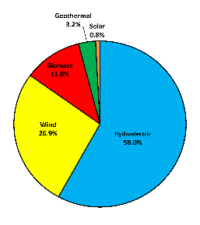
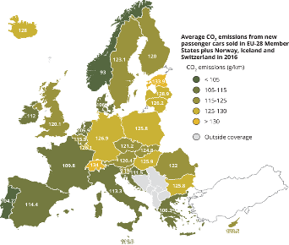
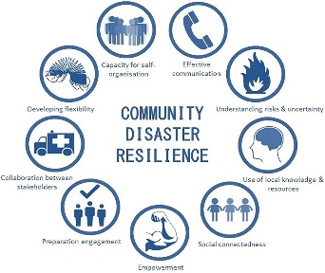
Solution Design
Proposed Solution:
Reduce CO2 Emissions: Implement policies and technologies to lower emissions.
Enhance Renewable Energy: Promote solar, wind, and other renewable sources.
Improve Disaster Preparedness: Develop infrastructure and emergency response systems.
Protect Coastal Areas: Invest in coastal defenses and sustainable land use.
Implementation Plan:
Policy Development:
Enact regulations to reduce emissions.
Provide incentives for renewable energy.
Technological Innovations:
Invest in clean energy technologies.
Scale up renewable energy infrastructure.
Alignment with SDGs:
SDG 13: Climate Action
SDG 7: Affordable and Clean Energy
SDG 11: Sustainable Cities and Communities
SDG 15: Life on Land
Community Engagement:
Conduct public education campaigns.
Support community-led resilience projects.
Monitoring and Evaluation:
Continuously monitor climate metrics.
Adjust strategies based on data insights.

Slide 10
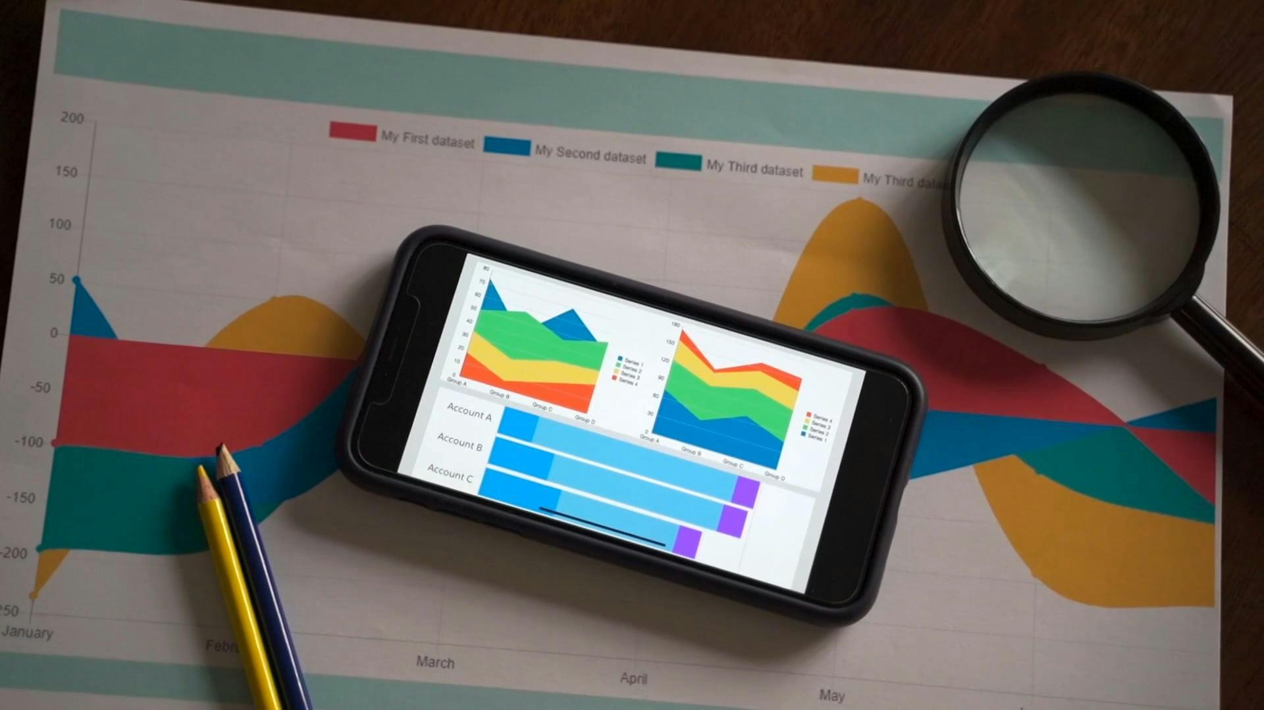
Visualization
Data Visualization Techniques Used:
Charts and Graphs:
Line Graphs: Show trends in global temperatures and CO2 emissions over time.
Bar Charts: Compare the frequency and intensity of extreme weather events.
Scatter Plots: Illustrate the correlation between CO2 levels and temperature changes.
Maps:
Heat Maps: Display regional temperature anomalies and hotspots.
Choropleth Maps: Highlight areas most affected by sea level rise.
Dashboards:
Interactive Dashboards: Created with Power BI and Tableau for real-time data exploration and analysis.
Key Visual Insights:
Global Temperature Rise: Clear upward trend in global temperatures, especially in recent decades.
CO2 Emissions Growth: Steady increase in CO2 emissions, with significant contributions from industrial sectors.
Extreme Weather Patterns: Increased frequency and intensity of extreme weather events such as hurricanes and floods.
Regional Vulnerabilities: Coastal areas show higher sea level rise, indicating greater vulnerability.

Slide 11
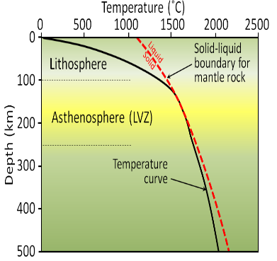
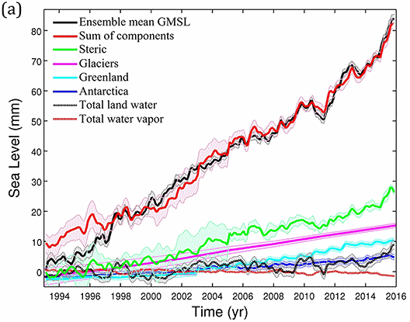
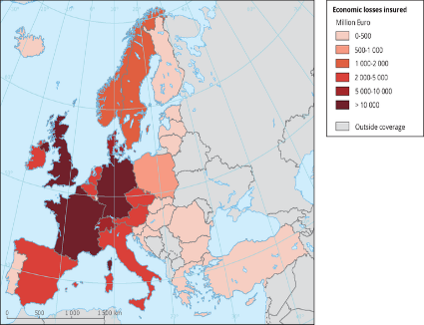
Conclusion
Summary of Findings:
Temperature Rise: Significant increase over the past century.
CO2 Emissions: Continuous rise from industrial sectors.
Sea Level Rise: Accelerated rise, especially in coastal areas.
Extreme Weather: Increased frequency and intensity linked to climate change.
Impact of Proposed Solution:
Reduced Emissions: Lower CO2 levels through policies and renewable energy.
Enhanced Resilience: Better preparedness for extreme weather events.
Protected Ecosystems: Mitigation of sea level rise impacts.
Informed Policy: Data-driven climate action.
Future Work:
Advanced Analytics: Use machine learning for climate predictions.
Broader Data: Incorporate diverse data sources.
Collaboration: Partner with global organizations.
Public Engagement: Raise awareness and involvement in climate initiatives.

Slide 12
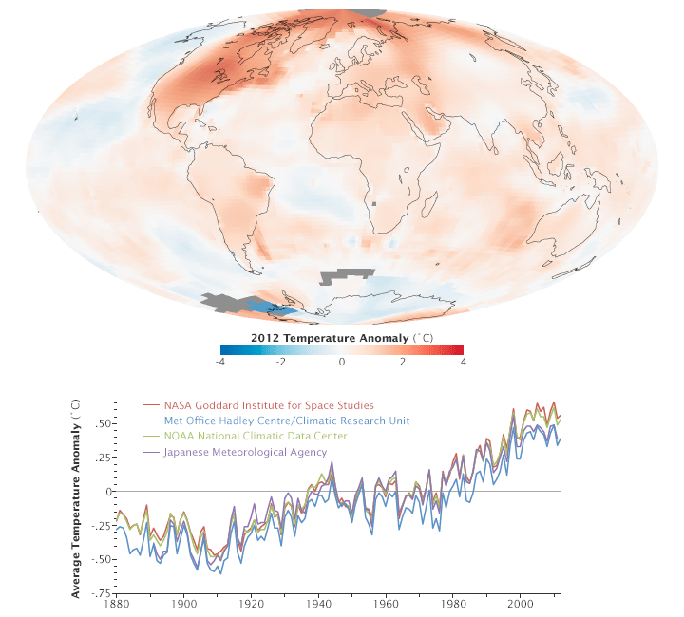
References
Data Sources:
Meteorological Agencies: Climate metrics and weather data.
Environmental Organizations: CO2 levels and biodiversity data.
Government Reports: Official climate statistics.
Research Institutions: Academic climate studies.
Tools and Software Used:
Python & Pandas: Data manipulation and analysis.
Power BI: Interactive dashboards and visualizations.
Seaborn & Matplotlib: Detailed data visualization.
Machine Learning Algorithms: Predictive analysis and pattern recognition.
Additional References:
IPCC Reports: Comprehensive climate change assessments.
NASA Climate Data: Satellite observations and climate indicators.
UN Climate Change Resources: Global climate policies and initiatives.
Peer-Reviewed Journals: Latest research on climate science.

